Slide 1

STEERING C.V.JOINT
TECHNICAL PRESENTATION
SPAJ 99-146
ALL MATERIAL IN THIS PRESENTATION IS CONFIDENTIAL
Property of NTN corporation

Slide 2
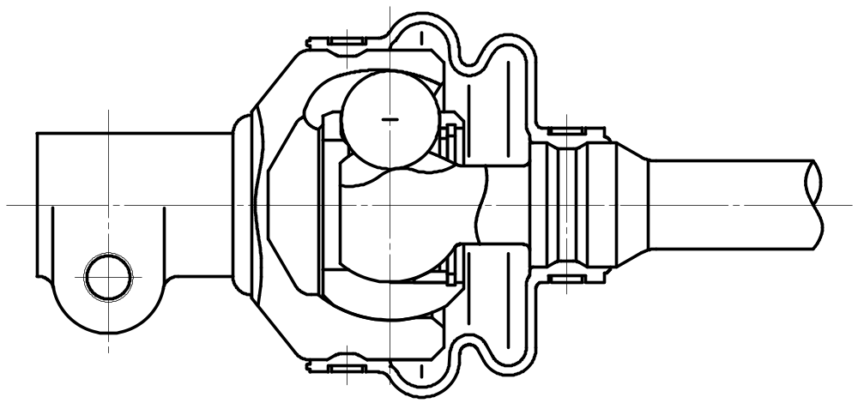
DESIGN CONCEPT
Compact design
Smooth operation
Minimum rotational lash
High angle capability (40deg)
Property of NTN corporation

Slide 3
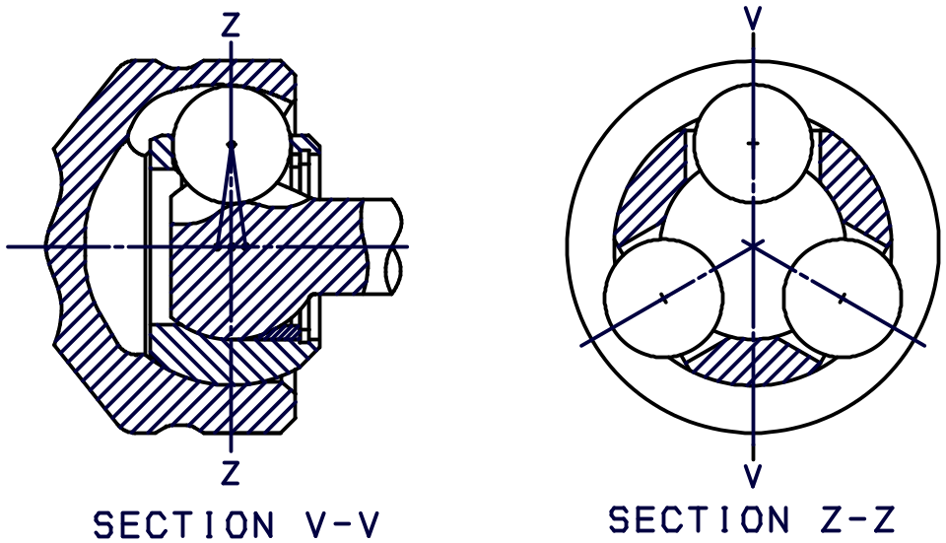
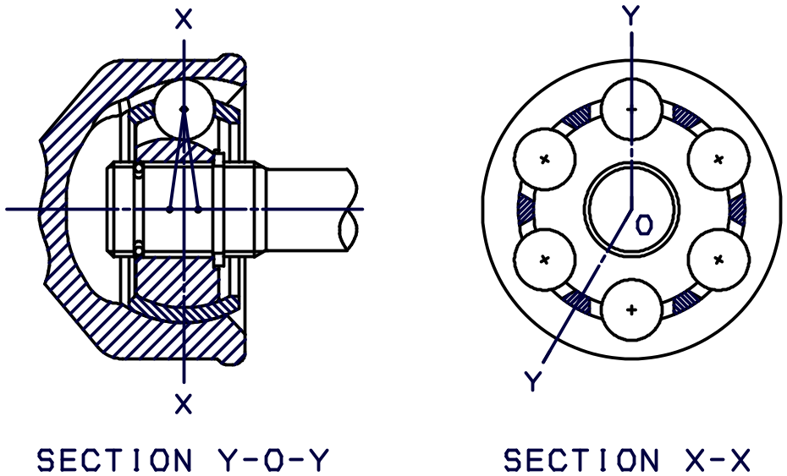
STEERING CVJ
BJ
Property of NTN corporation

Slide 4
COMPONENTS OF STEERING CVJ
Outer race
Ball
Boot
Boot clamp
Grease
Inner race - Shaft
Grease
Circlip
Boot clamp
Cage
Support ring
Property of NTN corporation

Slide 5
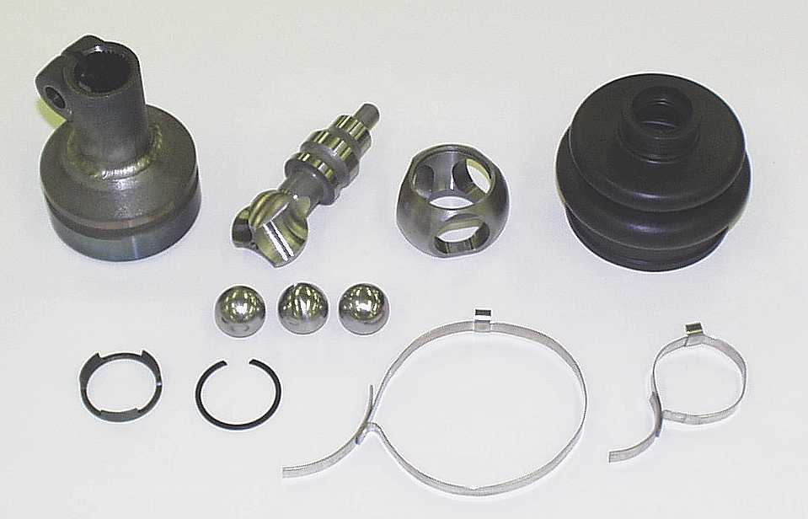
Property of NTN corporation

Slide 6
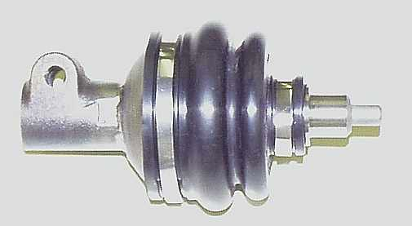
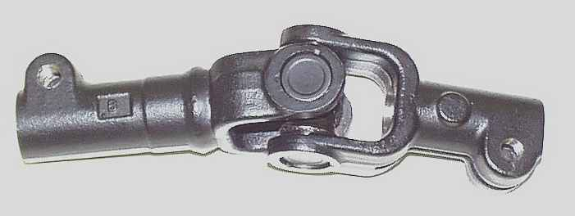
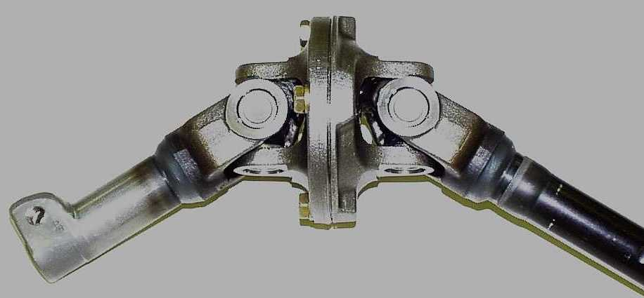
STEERING
C.V.JOINT
SINGLE CARDAN
UNIVERSAL JOINT
DOUBLE CARDAN UNIVERSAL JOINT
Property of NTN corporation

Slide 7
DOUBLE CARDAN
UNIVERSAL JOINT
SINGLE CARDAN
UNIVERSAL JOINT
STEERING C.V.JOINT
50mm Outer race
62mm Boot
Outer diameter
81mm
41mm
Weight
450gr
1180gr
280gr
Max. angle
40deg
52 ~ 62deg
25deg
Rotational lash
++
+
++
Rotating
torque
++
+
++
Torsional
strength
++
++
++
Durability
++
++
++
Layout
(Angle,Phase)
++
++
0
Sealing
(Water,Dust)
++
+
+
Property of NTN corporation

Slide 8
DEFINITION OF WEIGHT
STEERINGC.V.JOINT
SINGLE CARDAN
UNIVERSAL JOINT
DOUBLE CARDAN UNIVERSAL JOINT
: Weight
Property of NTN corporation

Slide 9
STEERING CVJ
[ Rotating torque ]
0.2Nm max. Joint angle : 35deg
[ Rotational lash ]
10' max. Joint angle : 0deg
Torque
+1Nm
Rotational lash
Torsional angle
-1Nm
Property of NTN corporation

Slide 10
STEERING CVJ
[ Durability ]
Torque 49Nm
Joint angle 35deg
Rotational angle -360 ~ +360 deg (0.1Hz)
No damage after 2 x 10⁵ cycles
[ Static torsional strength ]
Broken torque 324Nm
(Joint angle : 30deg)
Property of NTN corporation

